Slide 1
The Standard Normal Distribution
Chad Williams
University of Victoria

Slide 2
Lecture Outline
Standard Distributions and Scores
The Z-Score
Calculation Z-Scores (and back)
Calculating P-Values (Z-Table)
Calculating Z-Scores from P-values

Slide 3
Lecture Outline
Standard Distributions and Scores
The Z-Score
Calculation Z-Scores (and back)
Calculating P-Values (Z-Table)
Calculating Z-Scores from P-values

Slide 4
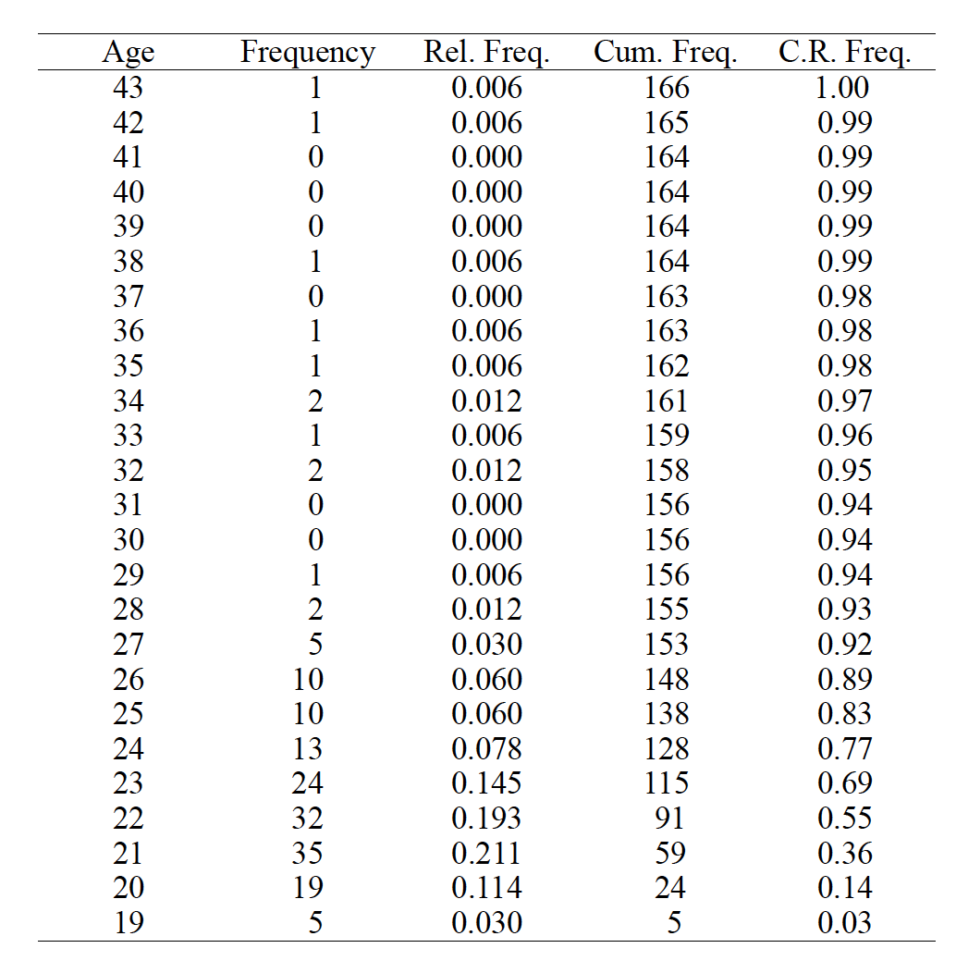
Distributions
Empirical: Built from a full set of real observed scores collected
Usually comes from a sample
Theoretical: Mathematically defined without a full set of real data
Used to represent an unknown population

Slide 5
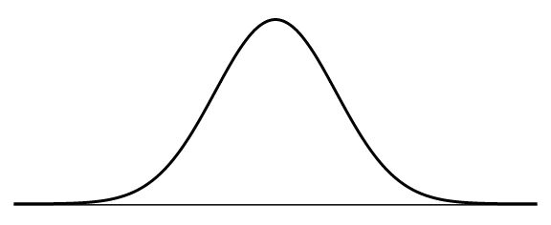
Distributions
The Normal Distribution: A distribution that can be mathematically defined
May be either empirical (real data) or theoretical (hypothetical data)
Unimodal, symmetric, mesokurtic
Necessary for the majority of inferential tests we will run

Slide 6
The Standard Normal Distribution
Standardization: The process of transforming our data into a standard (universal) unit of measurement
Our unit will be standard deviation (SD)
cm
lbs
ms
IQ
Neuroticism
SD

Slide 7
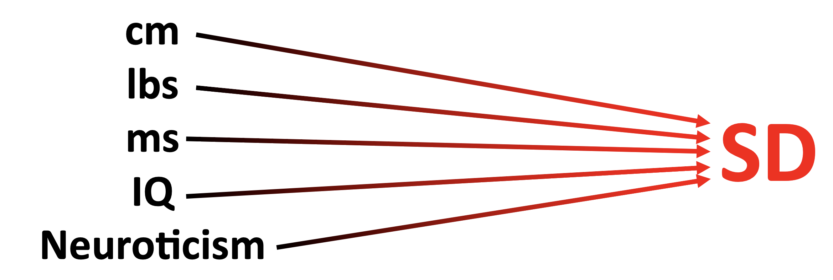
The Standard Normal Distribution
Standardization
Defines a score relative to other scores in the distribution
E.g., you get 78% on the midterm, is this good relative to the class?
If x̅ = 60%, then yes
If x̅ = 90%, then no

Slide 8
The Standard Normal Distribution
Standardization
Advantages
Defines a score relative to other scores in the distribution
Compares scores within the distribution
Can compare scores across distributions (!!!)

Slide 9
The Standard Normal Distribution
Standardization
Disadvantages
Comparing across distributions requires they are identically shaped (e.g., skew)

Slide 10
Lecture Outline
Standard Distributions and Scores
The Z-Score
Calculation Z-Scores (and back)
Calculating P-Values (Z-Table)
Calculating Z-Scores from P-values

Slide 11



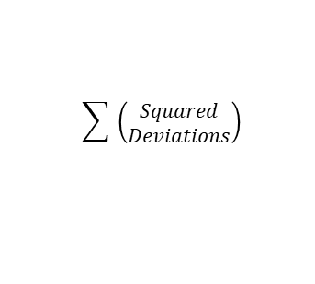

$$x − \bar{x}$$
$${deviations}^{2}$$
$$\sum{ \left(\begin{aligned}Squared \\ Deviations\end{aligned}\right)}$$
$$\frac{SS}{n}$$
$$\sqrt{{SD}^{2}}$$
X
Deviations
Squared
Deviations
Sum of Squares
(SS)
Variance
(SD²)
Standard
Deviation (SD)
Single Participant
Z-Score (Sample)
P-Value

Slide 12
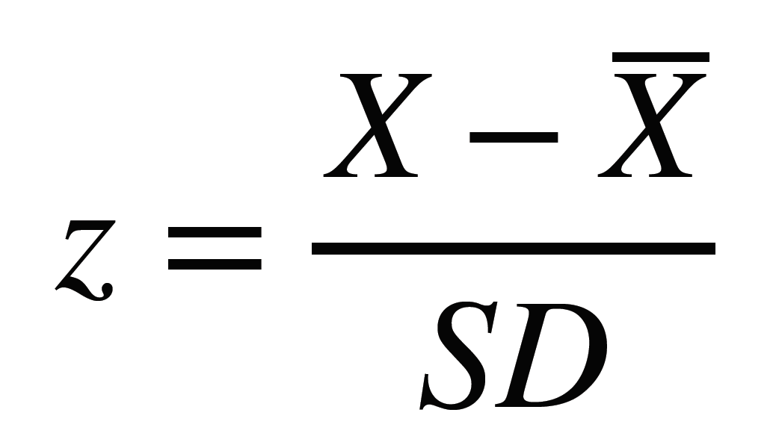
Z-Scores

Slide 13

$$x − \bar{x}$$
$${deviations}^{2}$$
$$\sum{ \left(\begin{aligned}Squared \\ Deviations\end{aligned}\right)}$$
$$\frac{SS}{n}$$
$$\sqrt{{SD}^{2}}$$
$$\frac{x − \bar{x} }{SD}$$
X
Deviations
Squared
Deviations
Sum of Squares
(SS)
Variance
(SD²)
Standard
Deviation (SD)
Single Participant
Z-Score (Sample)
P-Value

Slide 14
Z-Scores

Slide 15
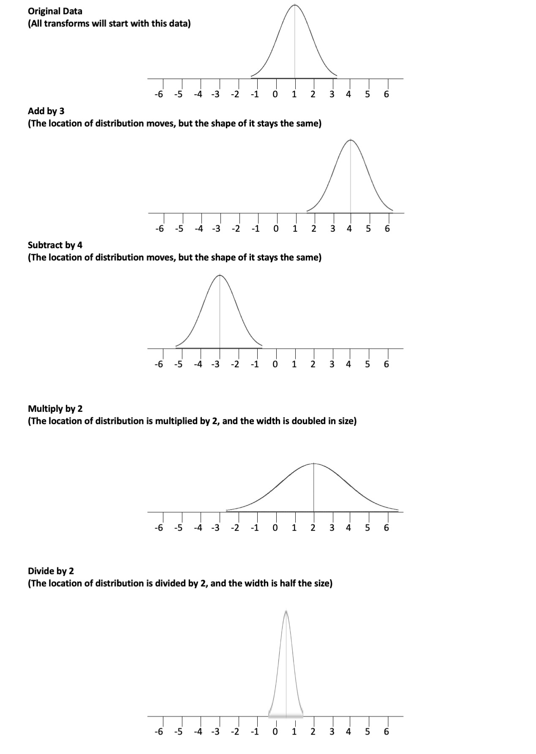
Z-Scores
Z-Scores: Score that indicates number of SDs the raw score is from the mean
Essentially, Z-Scores just require two shifts of our data.
We will subtract scores by our mean
This will center our data around zero
This means our new mean will be 0
This will tell us whether a score is above or below the mean
We will then divide scores by our SD
This will change the width of our distribution
This means our new SD will be 1
This will also change our scores to be in units of SD
And then we can say how many SD’s a score is above or below the mean

Slide 16
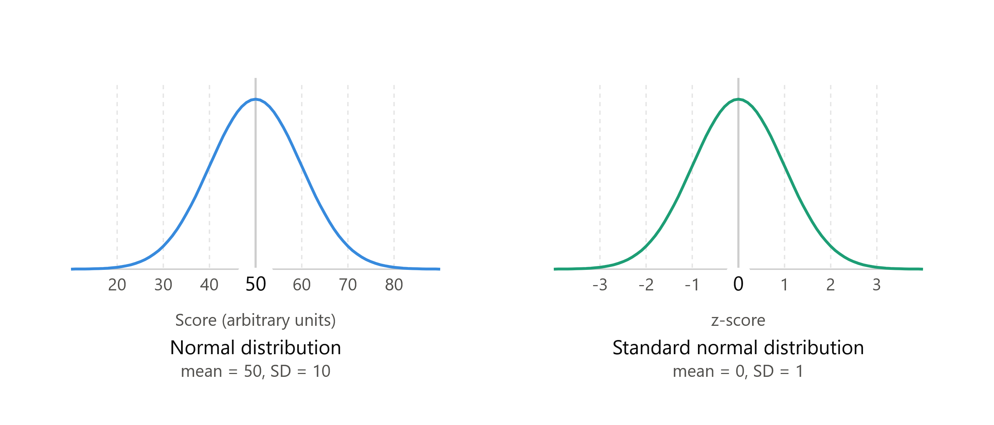
Z-Scores

Slide 17
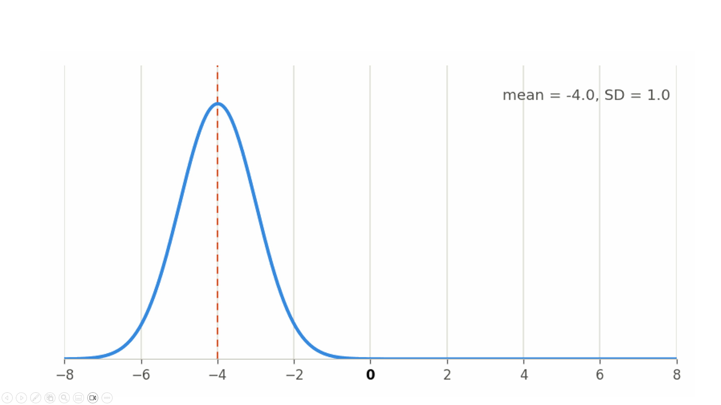

Slide 19
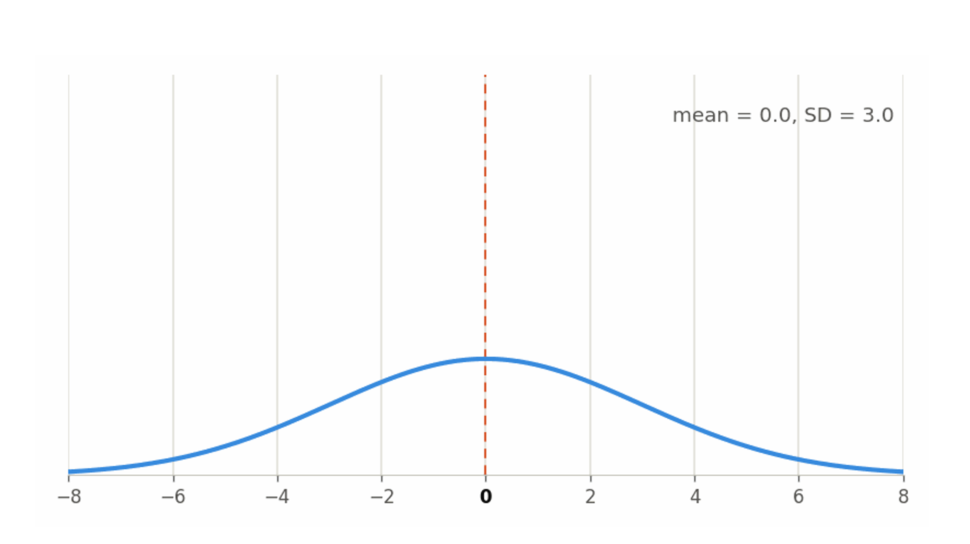

Slide 21
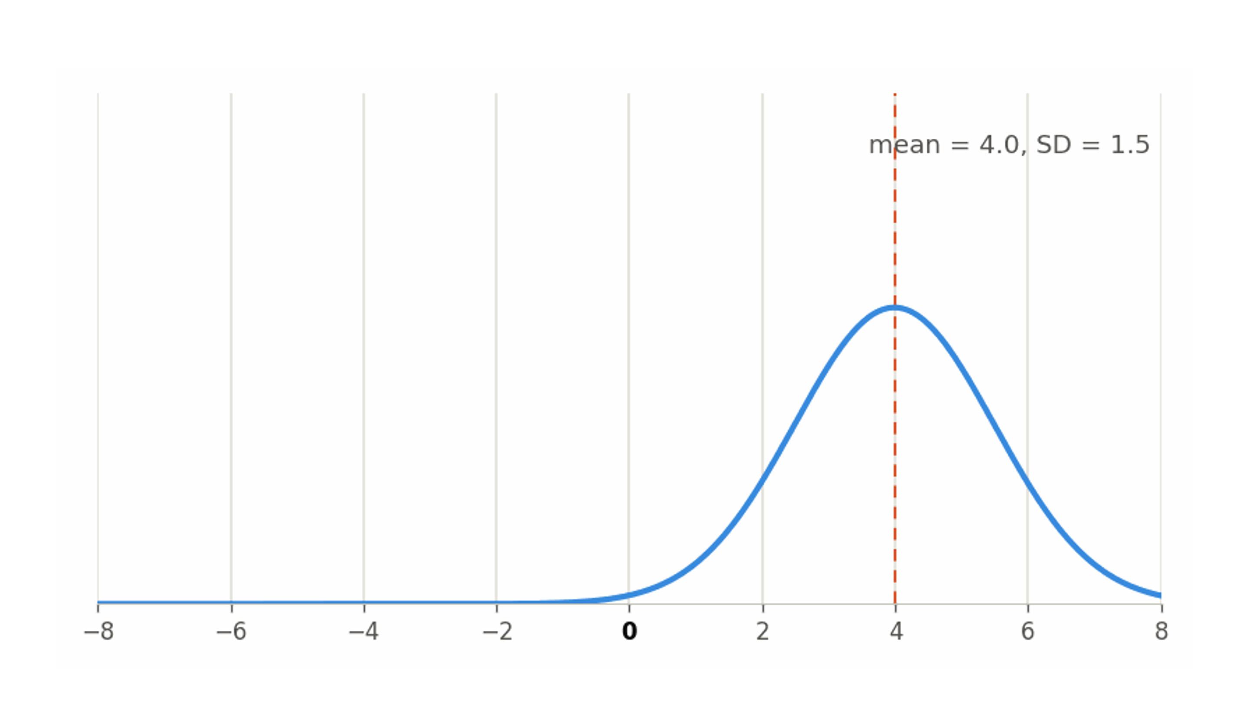

Slide 24
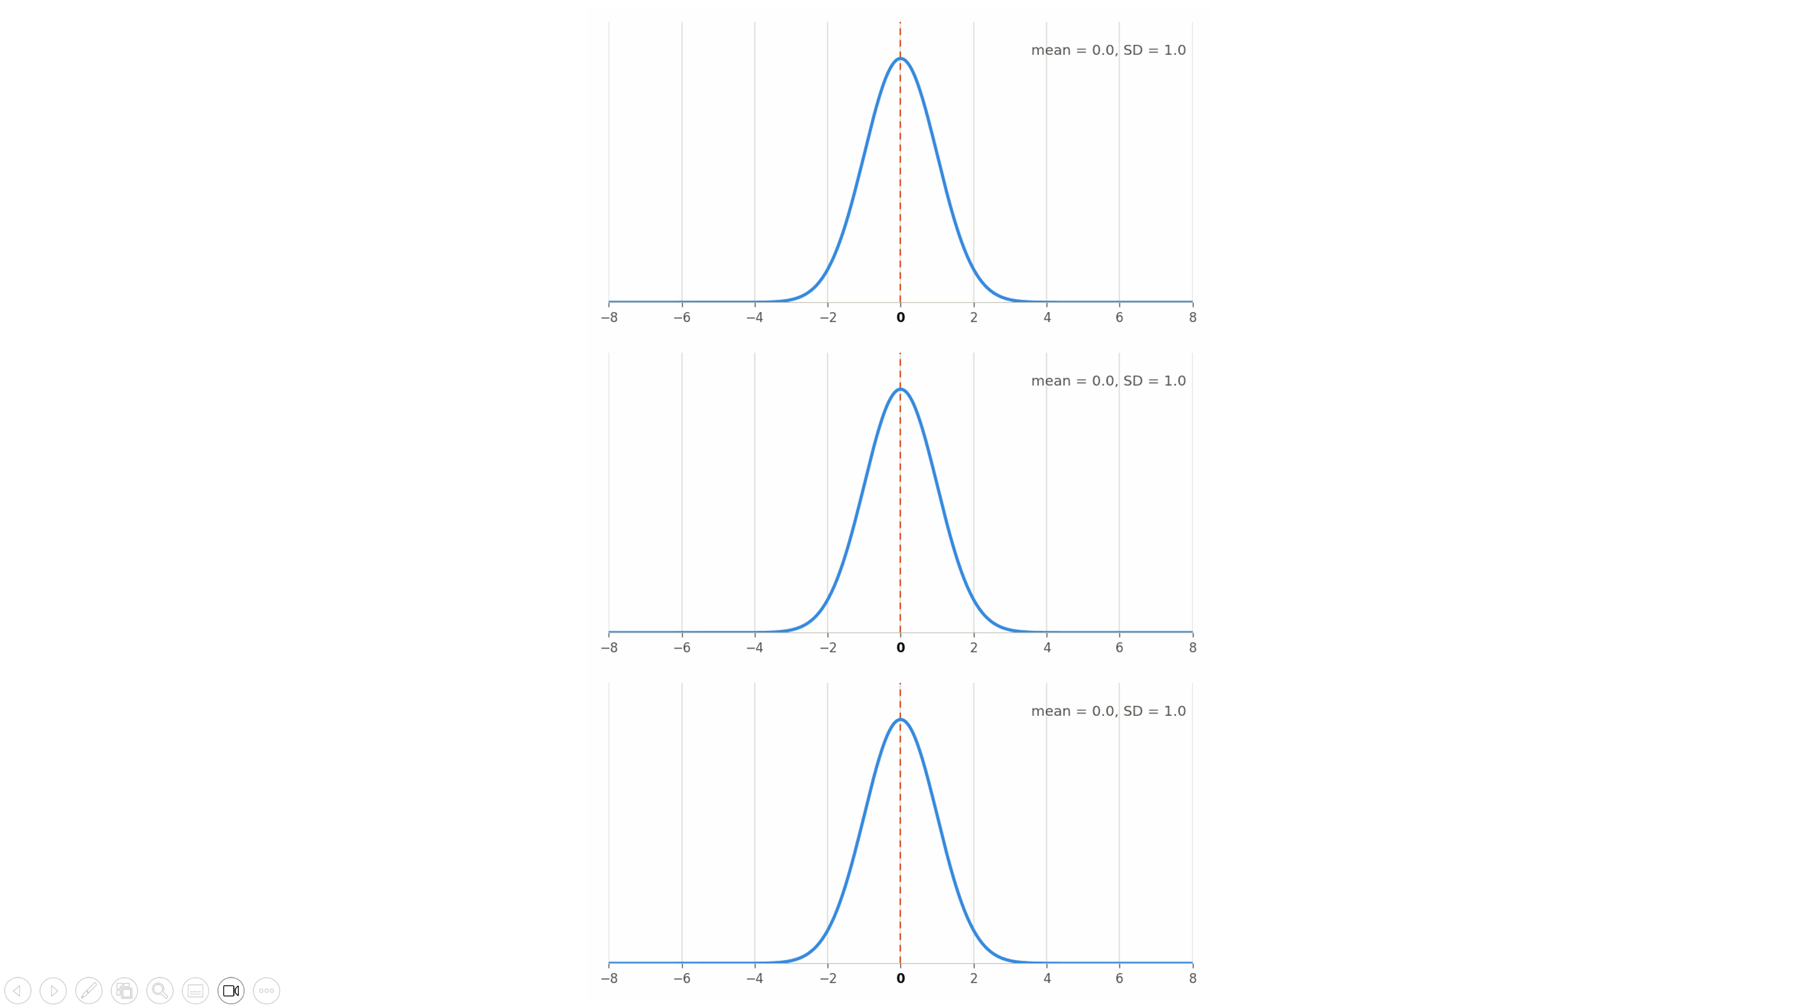

Slide 25
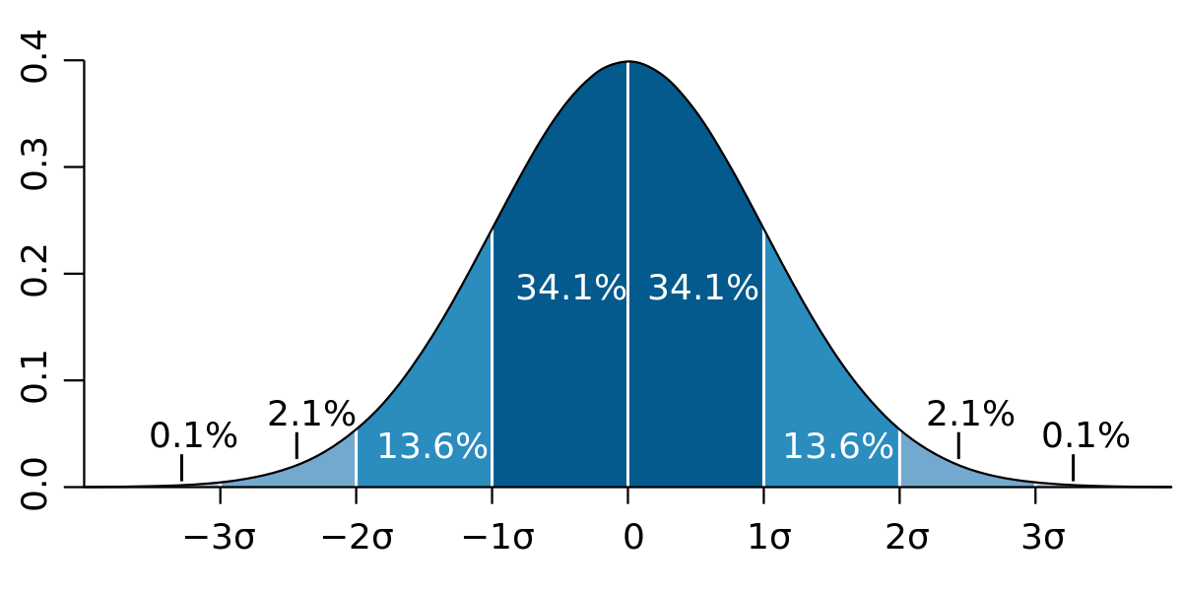
The Standard Normal Distribution

Slide 26
σ = SD

Slide 27

Jo got 90.00% on the exam
Exam mean = 75.00%
Exam SD = 14.00%
$$z = \frac{x−x̅}{SD}$$
$$z = \frac{90.0000−75.0000}{14.0000}$$
$$z = 1.0714$$
σ = SD

Slide 28

Jo got 90.00% on the exam
Exam mean = 95.00%
Exam SD = 7.00%
$$z = \frac{x−x̅}{SD}$$
$$z = \frac{90.0000−95.0000}{7.0000}$$
$$z = −0.7143$$
σ = SD

Slide 29

Jo was 1.60 SDs above the mean
Exam mean = 80.00%
Exam SD = 10.00%
$$x = x̅ + z(SD)$$
$$x = 80.0000 + 1.6000(10.0000)$$
$$x = 96.0000\%$$
σ = SD

Slide 30
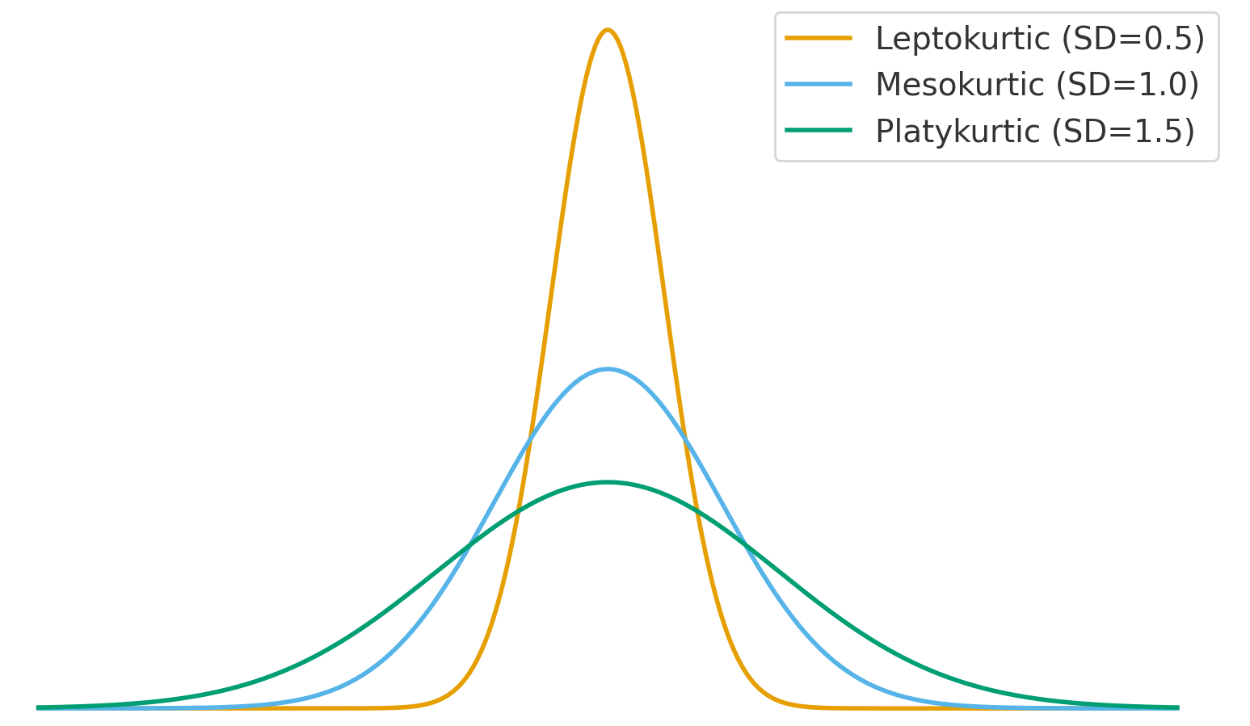
Standard Normal Distribution (SND)
The standardized form of raw scores
Interval and ratio scales
Shape is same as original data
It’s normal only when the original data is normal (otherwise it’s a standard distribution)
We assume all population distributions are normal (and thus our sample is from a normal distribution)
Remember, a normal distribution is:
Unimodal, symmetric, mesokurtic
So, the SND is too
Kurtosis: The peakedness of the distribution
platykurtic vs mesokurtic vs leptokurtic

Slide 31
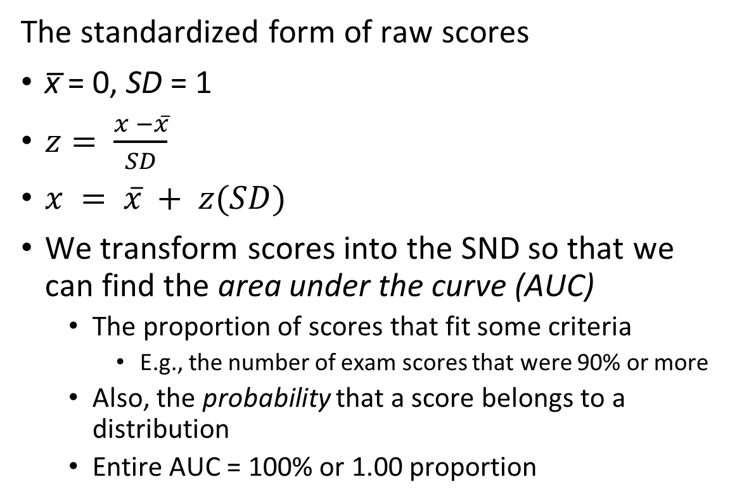
Standard Normal Distribution (SND)
The standardized form of raw scores
x̅ = 0, SD = 1
$z= \frac{x −x̅}{SD}$
$x = x̅ + z(SD)$
We transform scores into the SND so that we can find the area under the curve (AUC)
The proportion of scores that fit some criteria
E.g., the number of exam scores that were 90% or more
Also, the probability that a score belongs to a distribution
Entire AUC = 100% or 1.00 proportion

Slide 32
Lecture Outline
Standard Distributions and Scores
The Z-Score
Calculation Z-Scores (and back)
Calculating P-Values (Z-Table)
Calculating Z-Scores from P-values

Slide 33
Distributions

Slide 35
0.94 – 0.83 = 0.11

Slide 36

$$x − \bar{x}$$
$${deviations}^{2}$$
$$\sum{ \left(\begin{aligned}Squared \\ Deviations\end{aligned}\right)}$$
$$\frac{SS}{n}$$
$$\sqrt{{SD}^{2}}$$
$$\frac{x − \bar{x} }{SD}$$
Z-score
Table
X
Deviations
Squared
Deviations
Sum of Squares
(SS)
Variance
(SD²)
Standard
Deviation (SD)
Single Participant
Z-Score (Sample)
P-Value

Slide 37
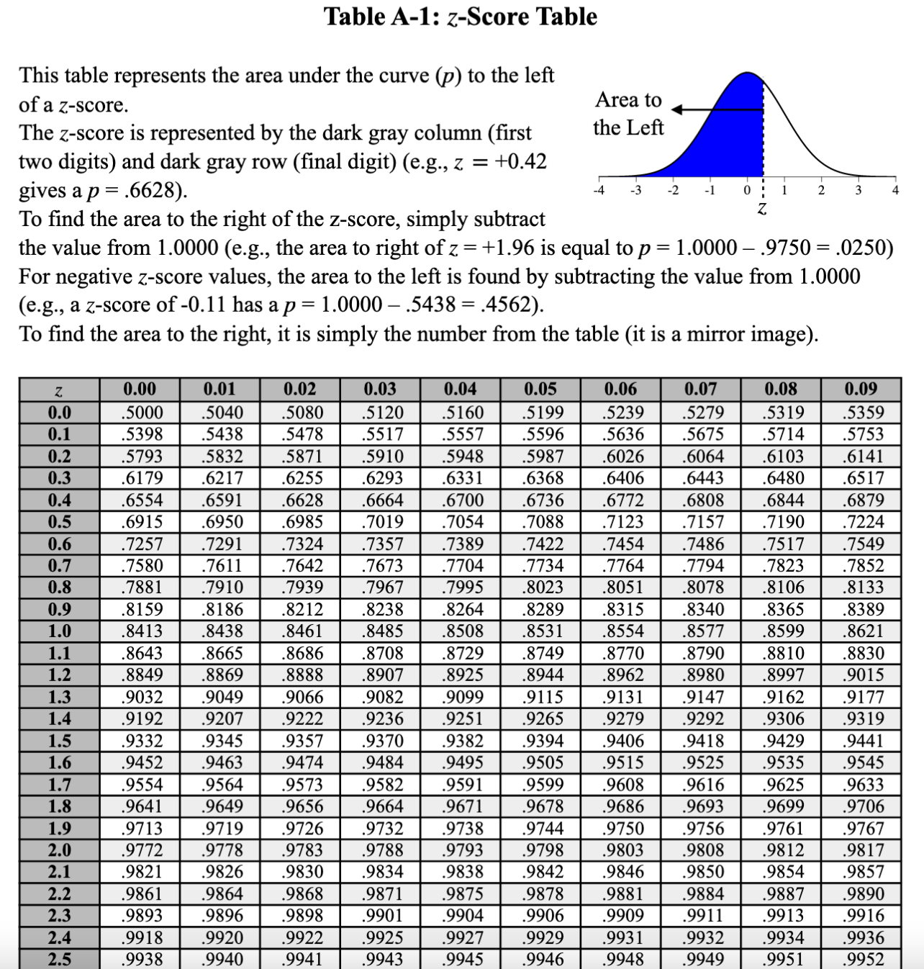

Slide 38
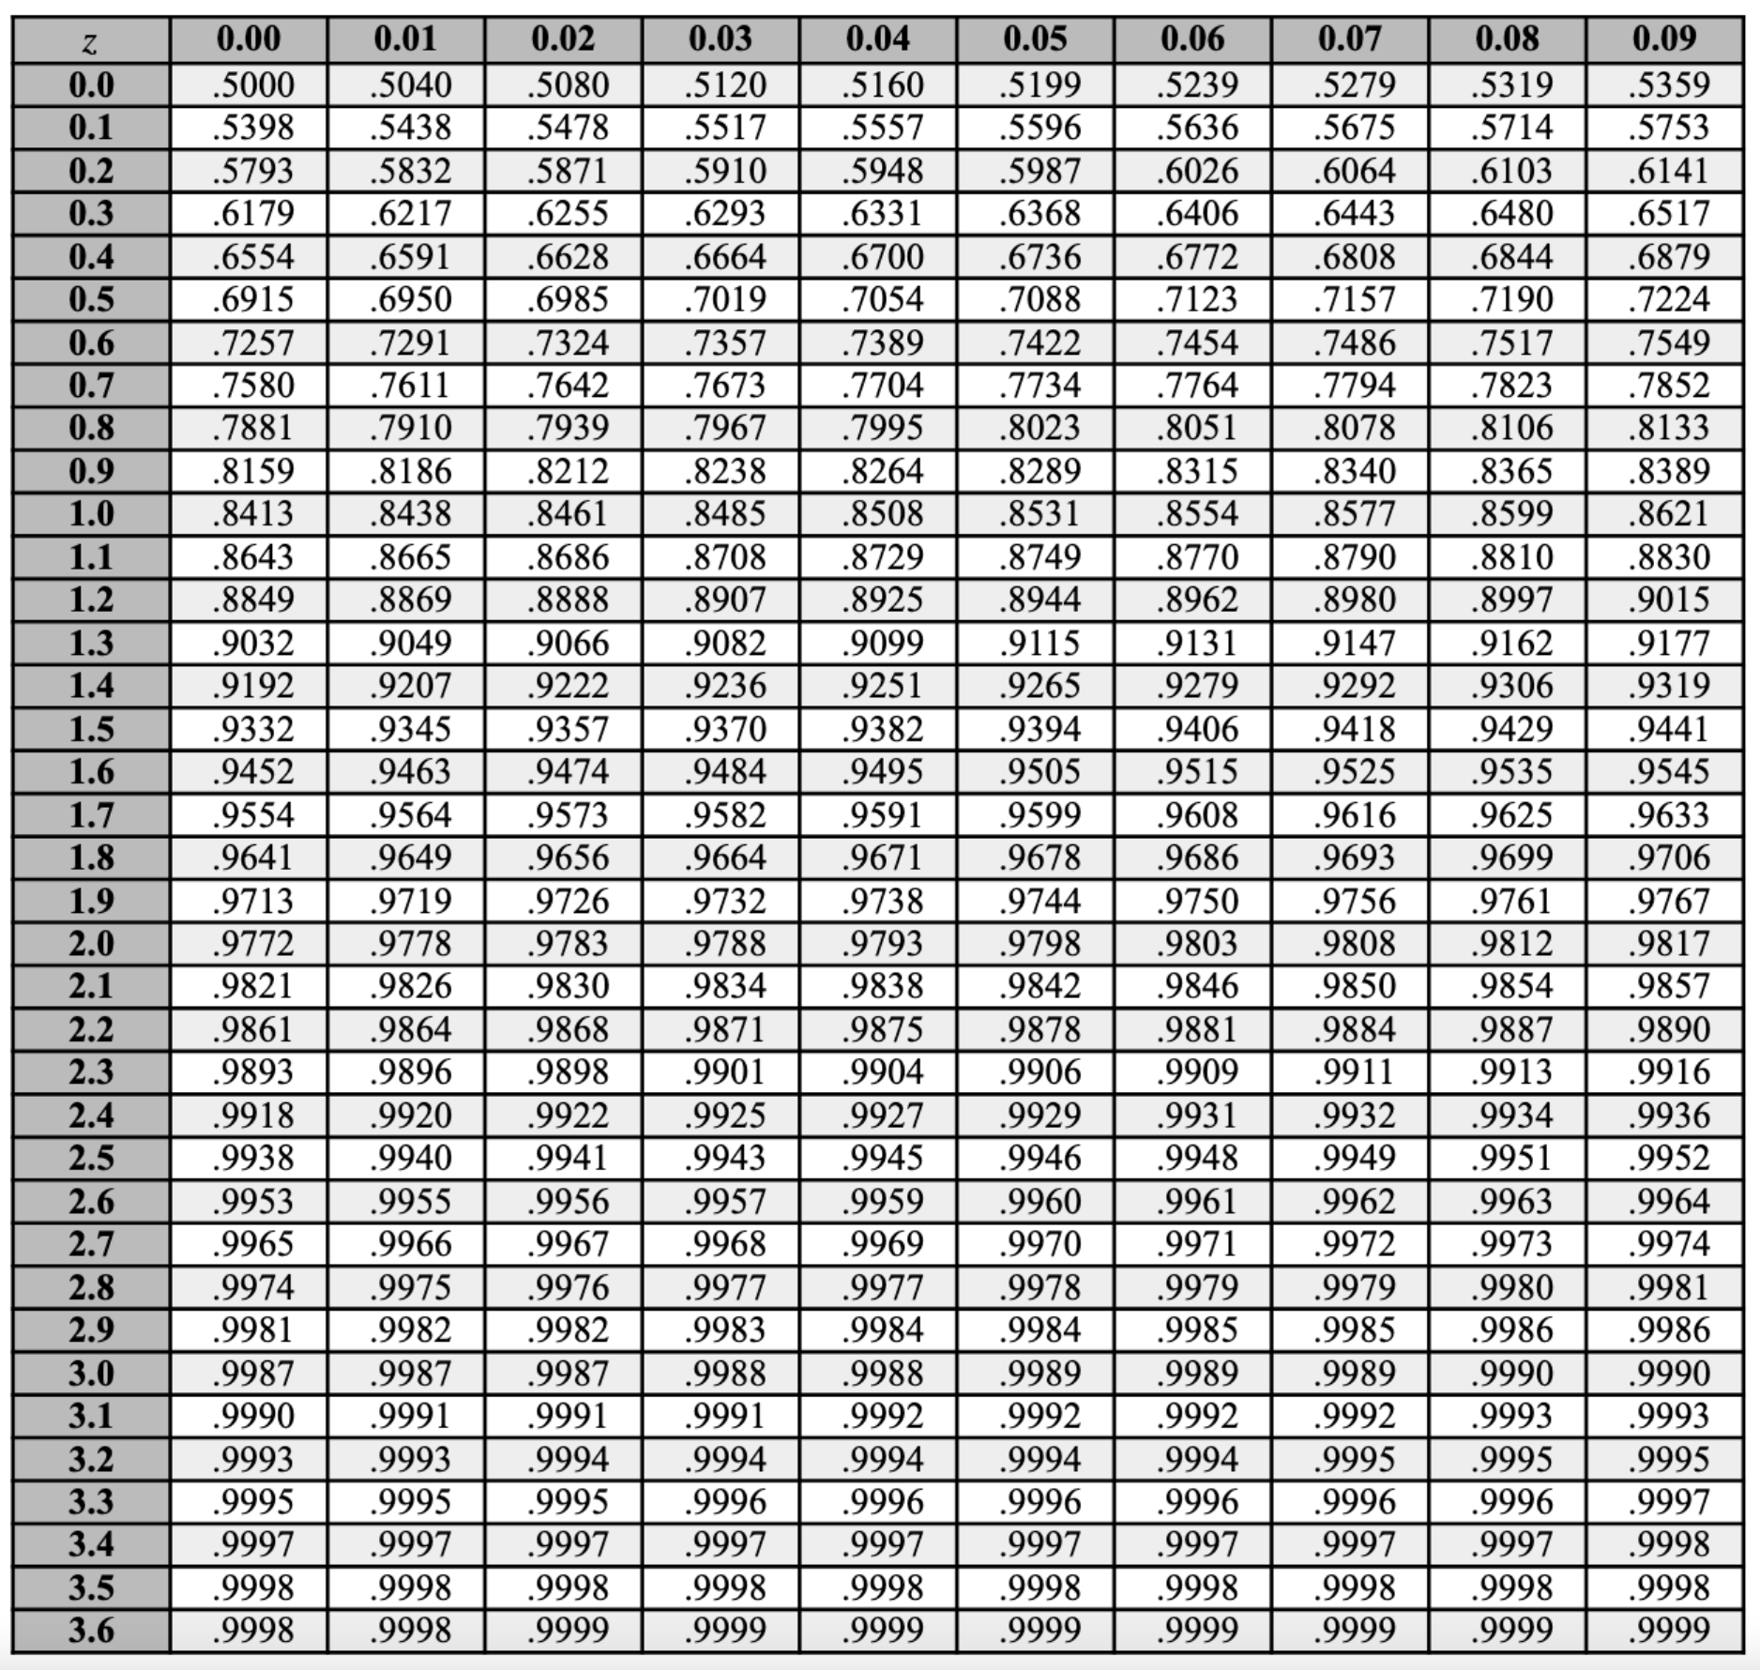
Columns =
1.23
Z-Score = 1.23
P-Value = .8907
Rows =
1.23

Slide 39
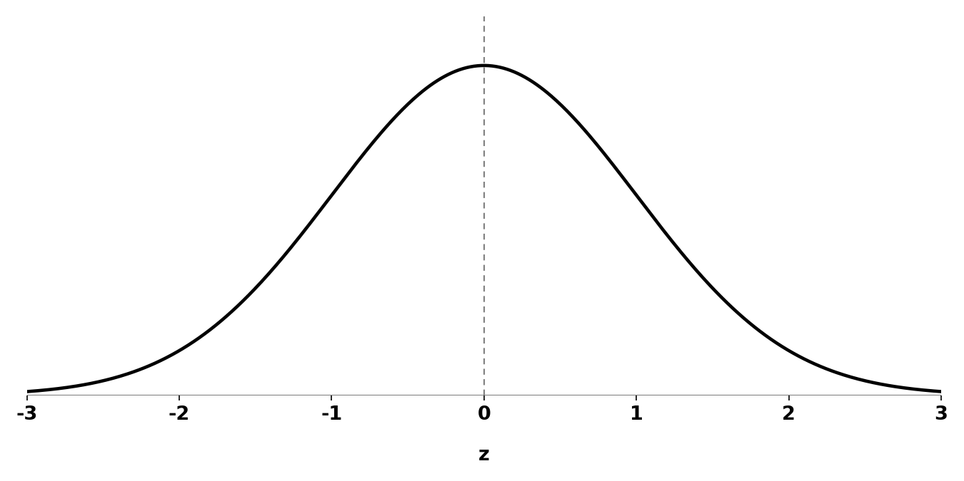
Z-Scores to P-Values
 | And below | And above
Positive z | p | 1 - p
Negative z | 1 - p | p

Slide 40
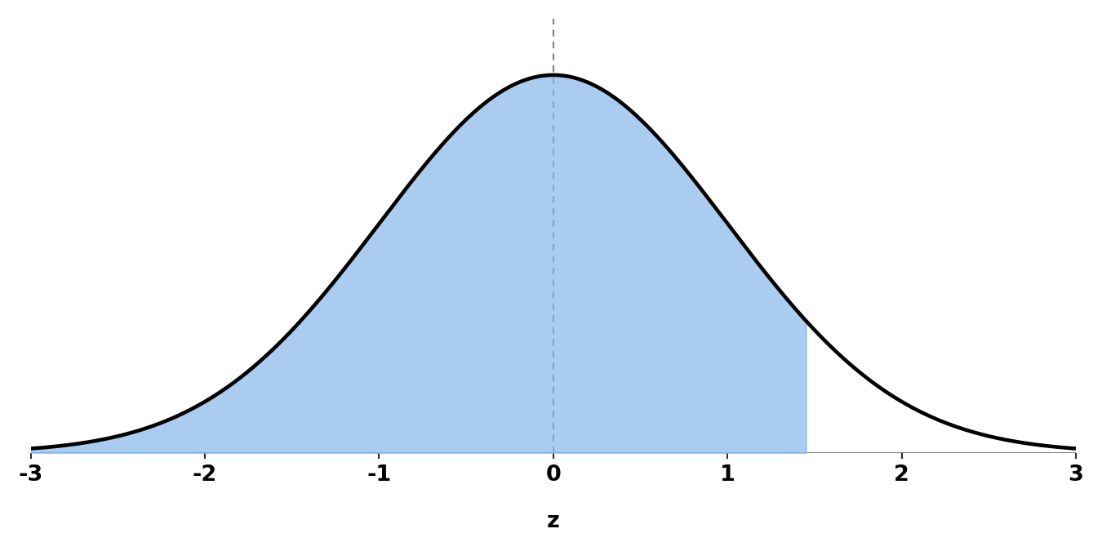
Z-Scores to P-Values
Proportion of scores that are
z = 1.45 and below

Slide 41
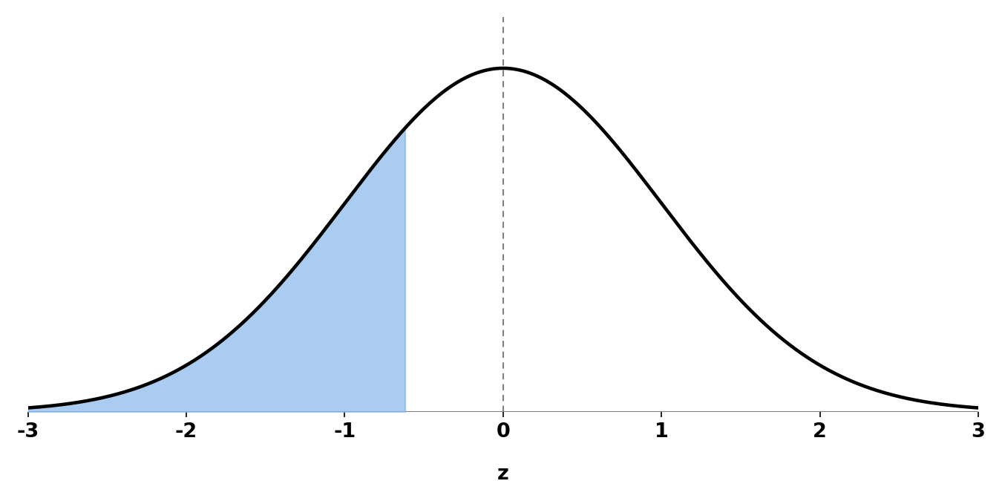
Z-Scores to P-Values
Proportion of scores that are
z = -0.62 and below
p = 1 - .7324 = .2676

Slide 42
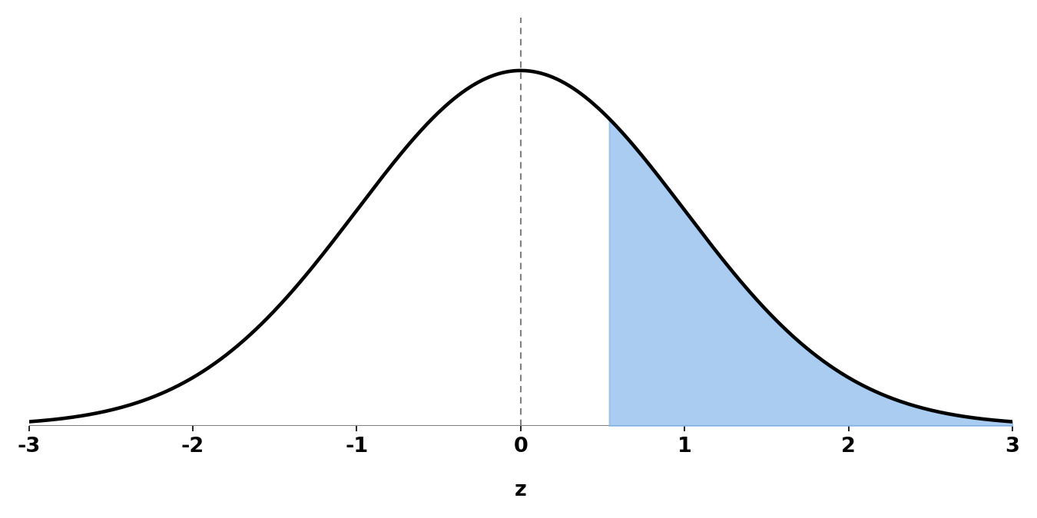
Z-Scores to P-Values
Proportion of scores that are
z = 0.54 and above
p = 1 - .7054 = .2946

Slide 43
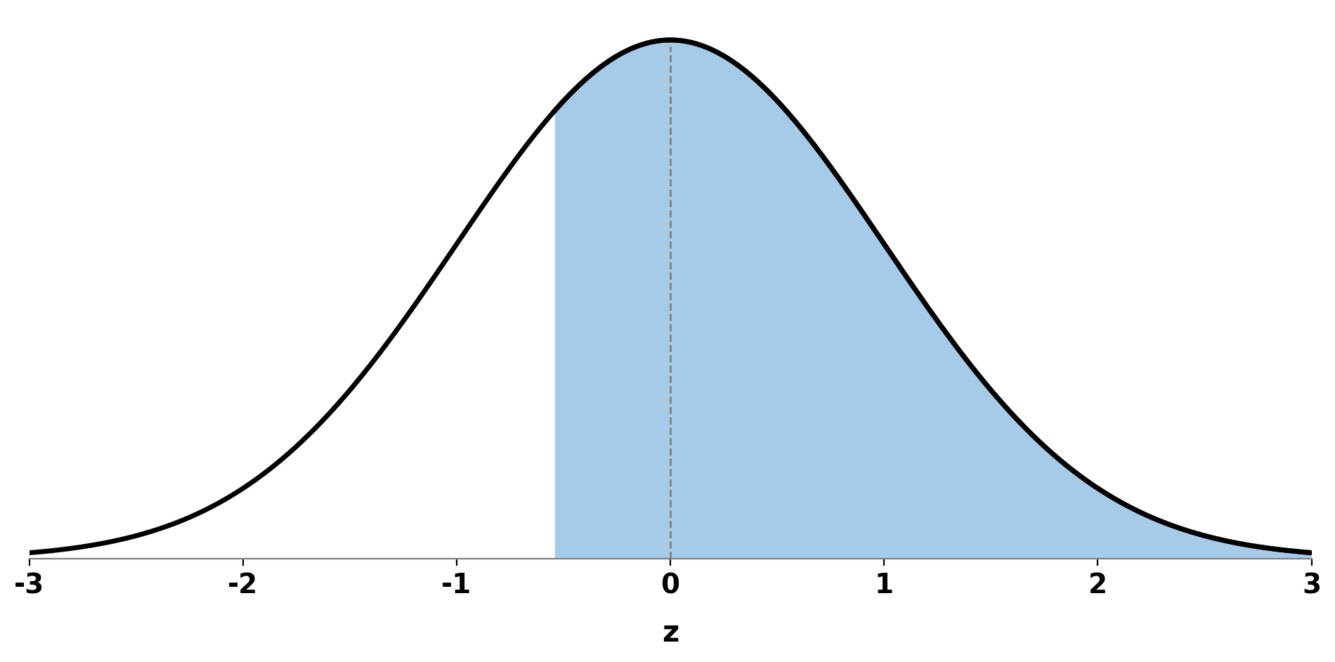
Z-Scores to P-Values
Proportion of scores that are
z = -0.54 and above

Slide 44
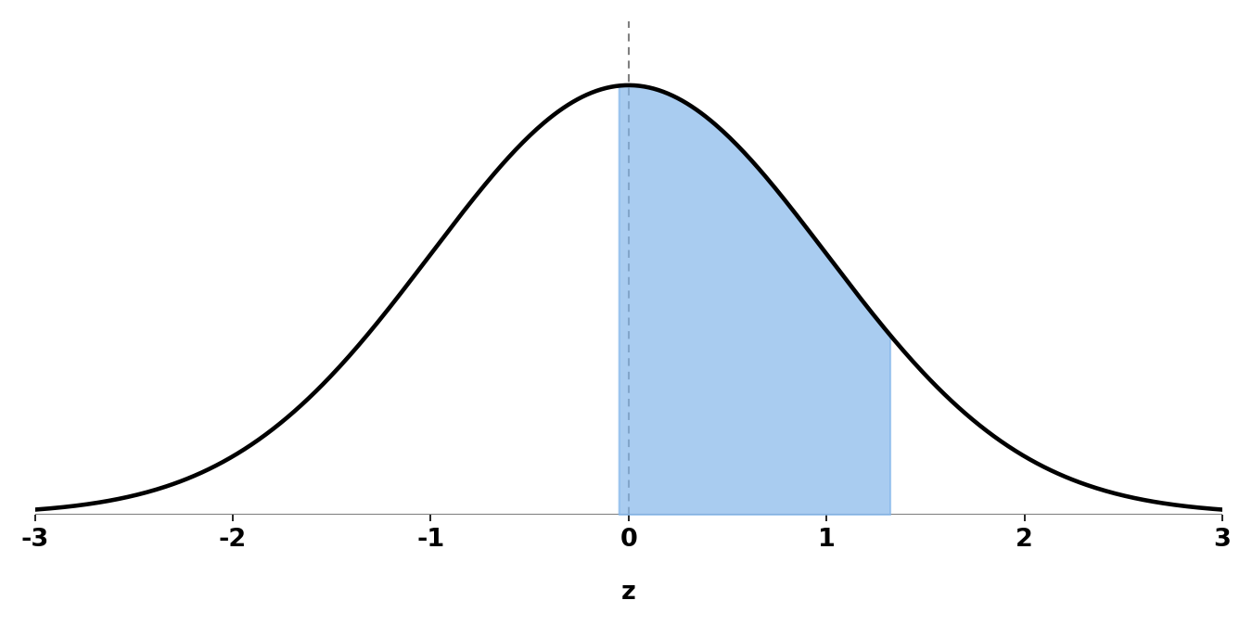
Z-Scores to P-Values
Proportion of scores that are between z = 1.32 and z = -0.05
z = 1.32; p = .9066

Slide 45
Z-Scores to P-Values
Proportion of scores that are between z = 1.32 and z = -0.05
z = 1.32; p = .9066
z = -0.05;
p = 1 - .5199 = .4801

Slide 46
Z-Scores to P-Values
Proportion of scores that are between z = 1.32 and z = -0.05
z = 1.32; p = .9066
z = -0.05; p = .4801
.9066 - .4801 = .4265

Slide 47
Z-Scores to P-Values
 | And below | And above
Positive z | p | 1 - p
Negative z | 1 - p | p

Slide 48
Lecture Outline
Standard Distributions and Scores
The Z-Score
Calculation Z-Scores (and back)
Calculating P-Values (Z-Table)
Calculating Z-Scores from P-values

Slide 49
$$x − \bar{x}$$
$${deviations}^{2}$$
$$\sum{ \left(\begin{aligned}Squared \\ Deviations\end{aligned}\right)}$$
$$\frac{SS}{n}$$
$$\sqrt{{SD}^{2}}$$
$$\frac{x − \bar{x} }{SD}$$
Z-score
Table
X
Deviations
Squared
Deviations
Sum of Squares
(SS)
Variance
(SD²)
Standard
Deviation (SD)
Single Participant
Z-Score (Sample)
P-Value
Z-score
Table

Slide 50
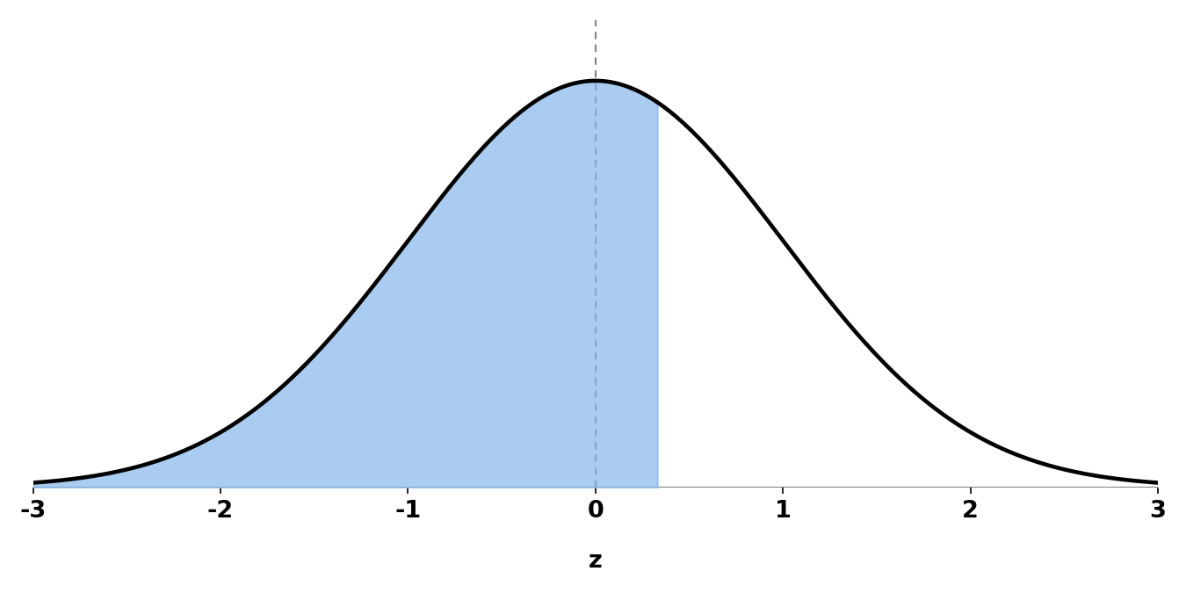
P-Values to Z-Scores
What is the Z-Score for
P-Value = .6293
z = 0.33

Slide 51
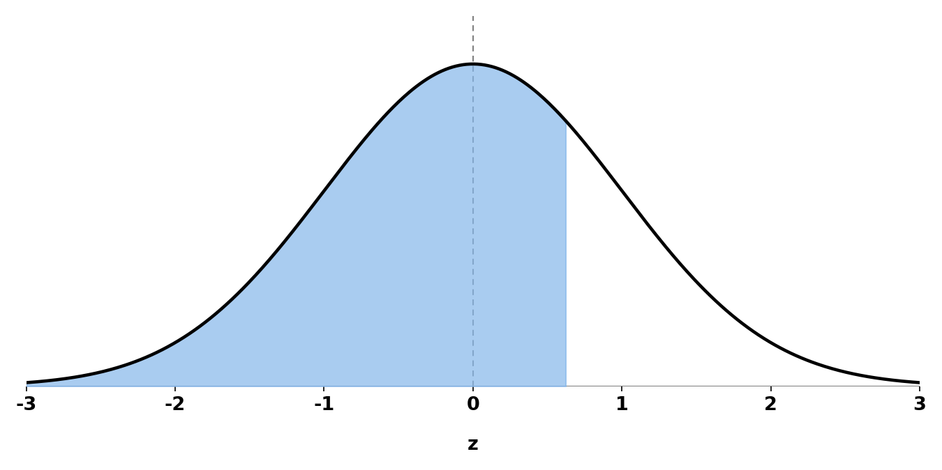
P-Values to Z-Scores
Quick note: Sometimes you need to find the closest p-value
What is the Z-Score for
P-Value = .7330
z = 0.62

Slide 52
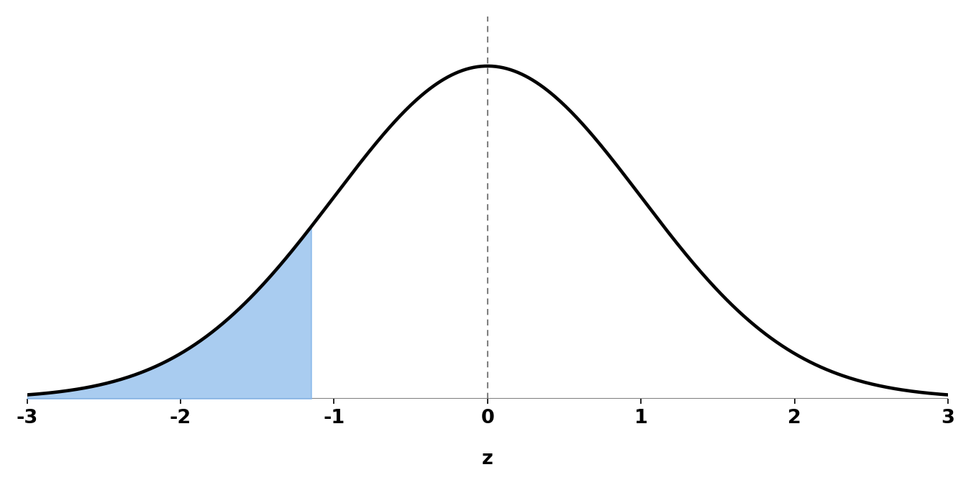
P-Values to Z-Scores
What is the Z-Score for
P-Value = .1251
1 - .1251 = .8749
z = -1.15

Slide 53
$$x − \bar{x}$$
$${deviations}^{2}$$
$$\sum{ \left(\begin{aligned}Squared \\ Deviations\end{aligned}\right)}$$
$$\frac{SS}{n}$$
$$\sqrt{{SD}^{2}}$$
$$\frac{x − \bar{x} }{SD}$$
Z-score
Table
X
Deviations
Squared
Deviations
Sum of Squares
(SS)
Variance
(SD²)
Standard
Deviation (SD)
P-Value
Single Participant
Z-Score (Sample)
Z-score
Table

Slide 54
Extra Resources

Slide 55
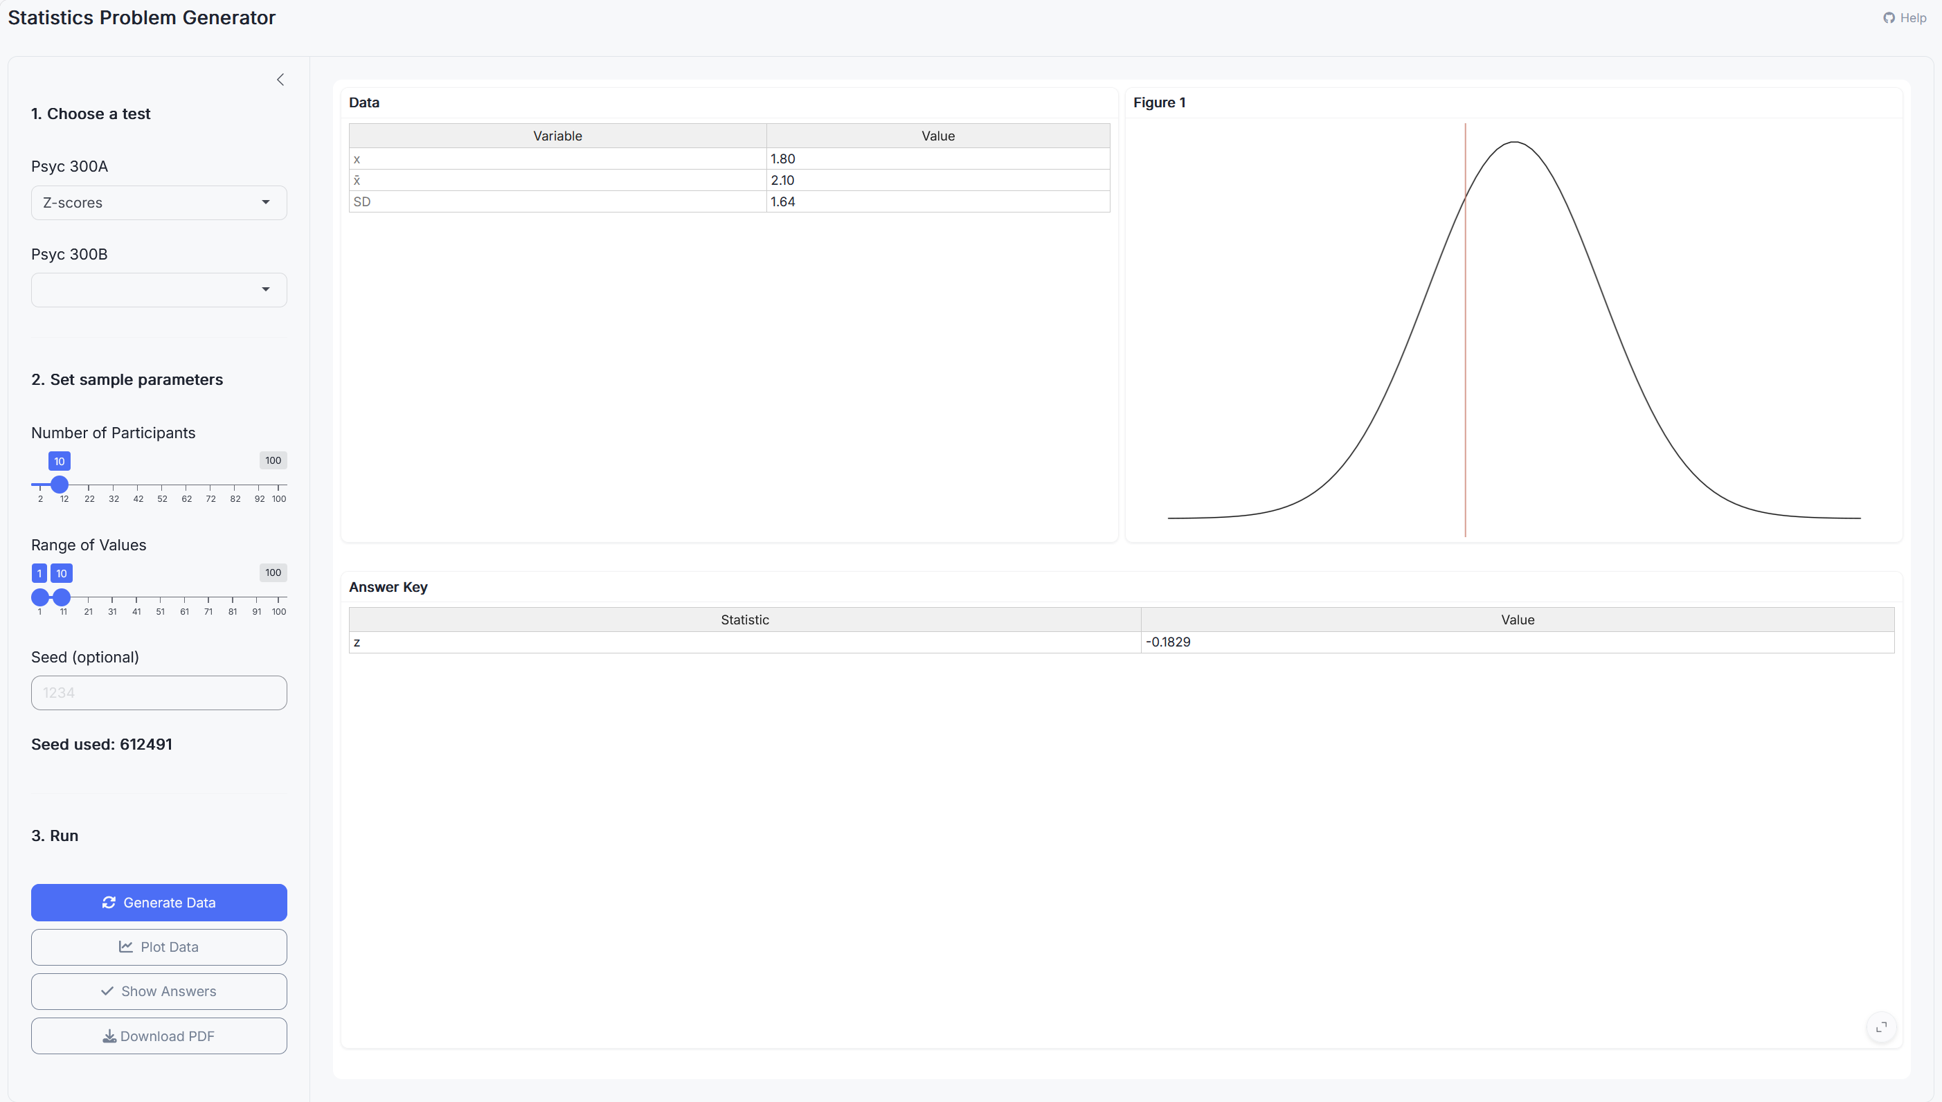
Stats Problem Generator
https://chadcwilliams.shinyapps.io/StatsProblemGenerator/

Slide 56
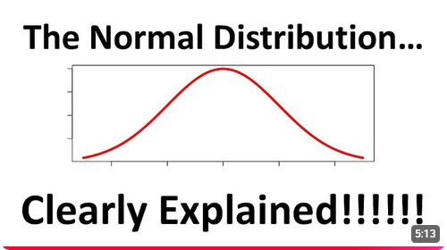
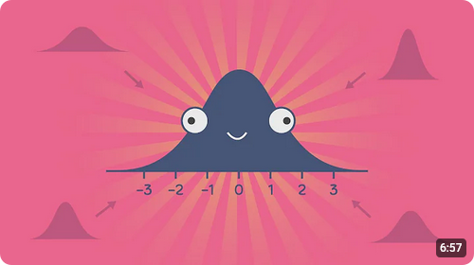
Extra Resources

